Slide 1
The Microbiome: Methods, Tools, and Examples
W. Evan Johnson, Ph.D.
Divsion of Computational Biomedicine, BUSM
Department of Biostatistics, BUSPH
Bioinformatics Program, BU
Email: wej@bu.edu
Twitter: @wejlab

Slide 2
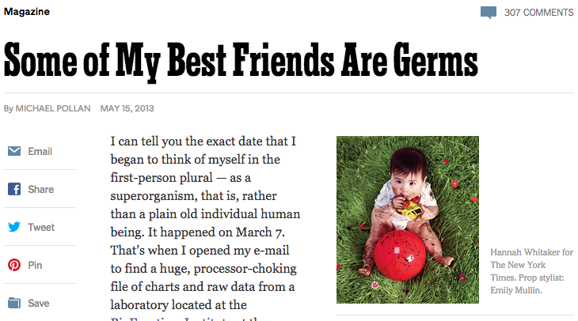




Slide 3

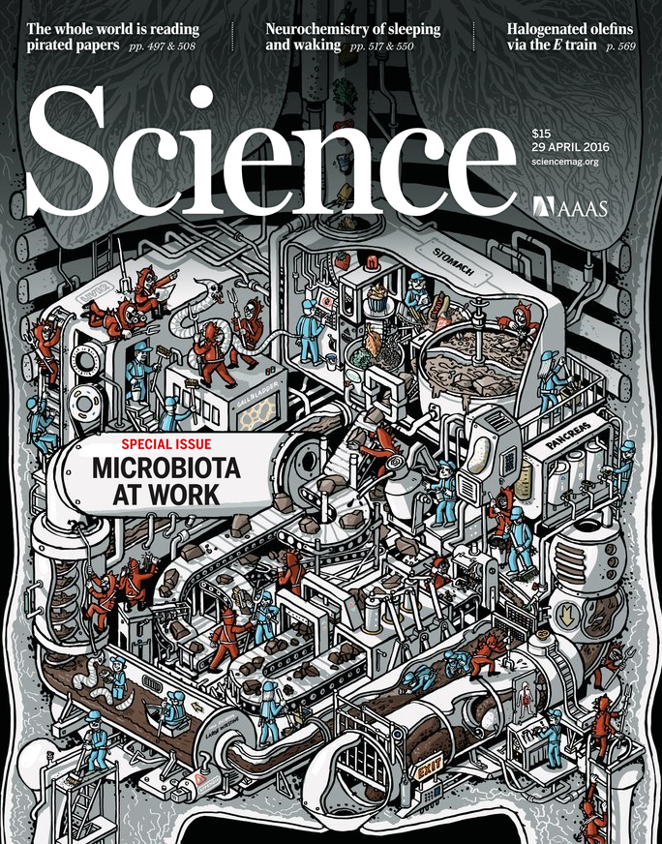
Notes:
The microbiome is popular; both Science and Nature have had special issues all about it.

Slide 4
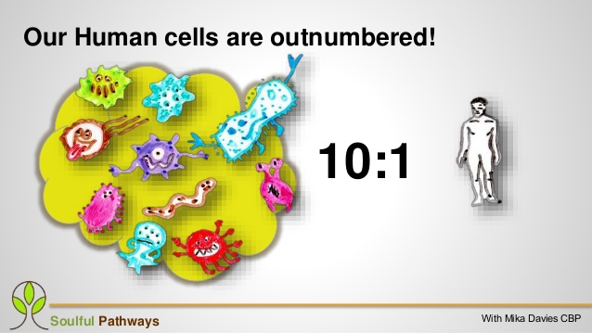


Slide 5
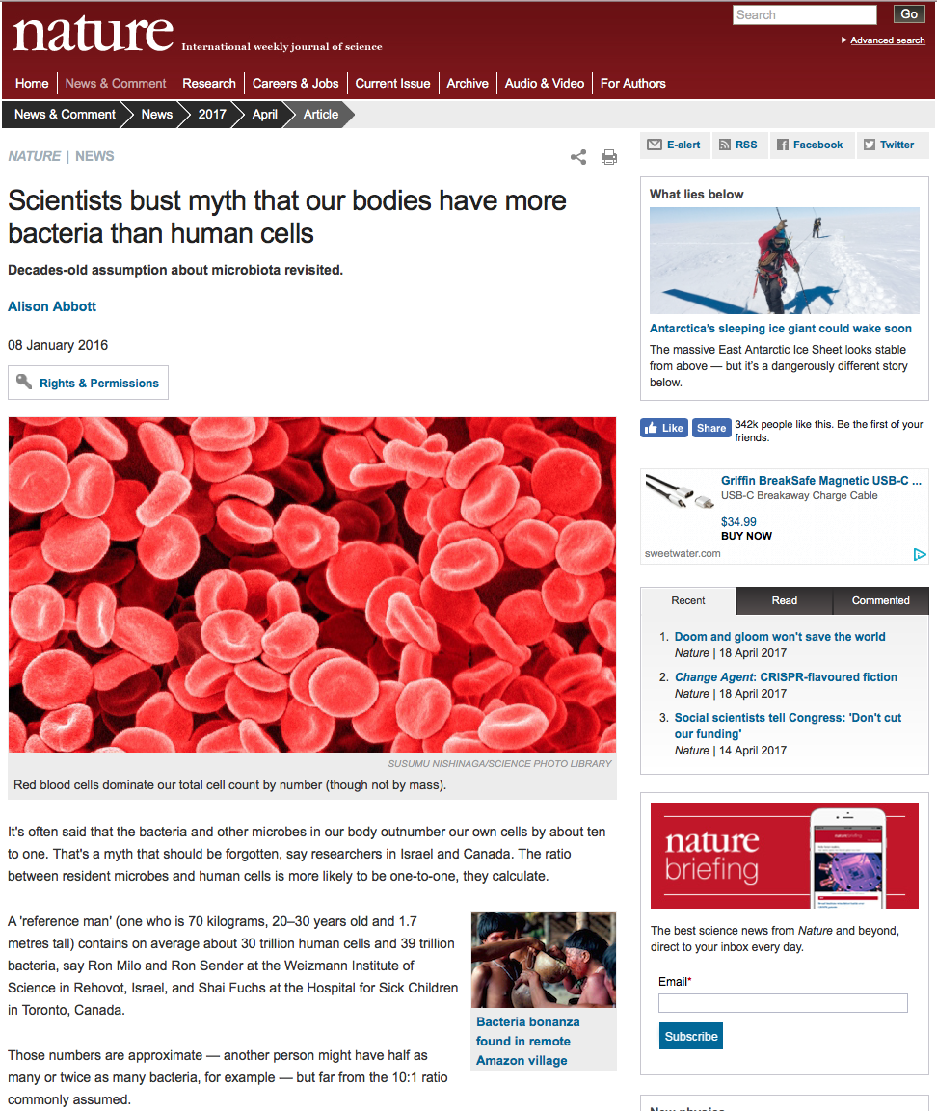

Slide 7
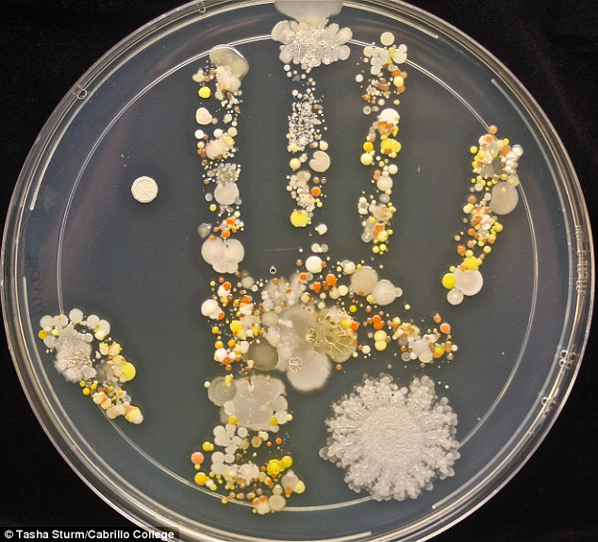

Slide 8
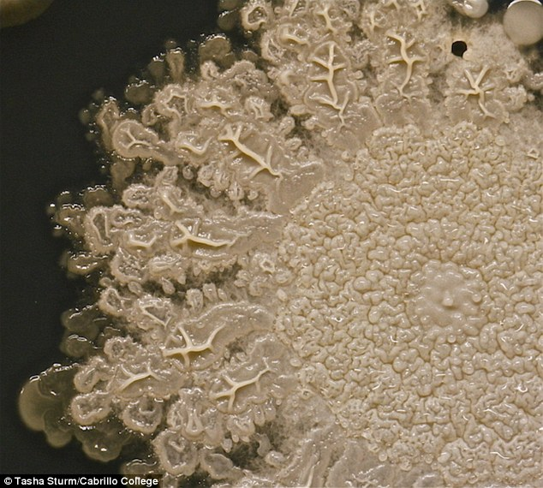
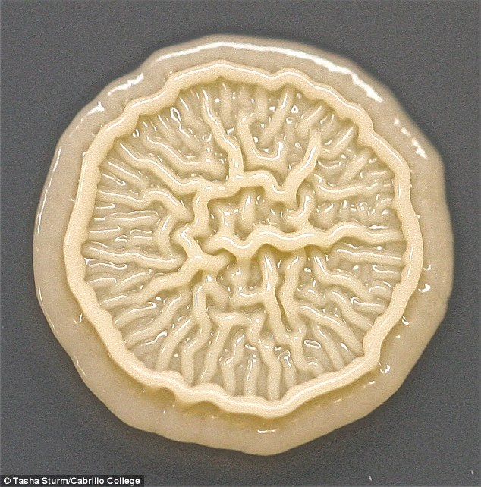
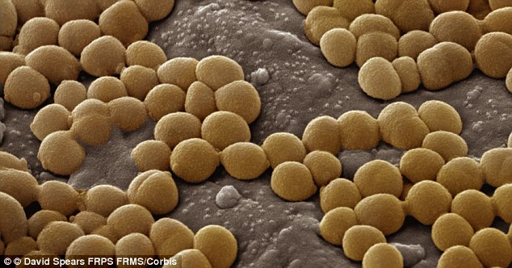

Slide 9
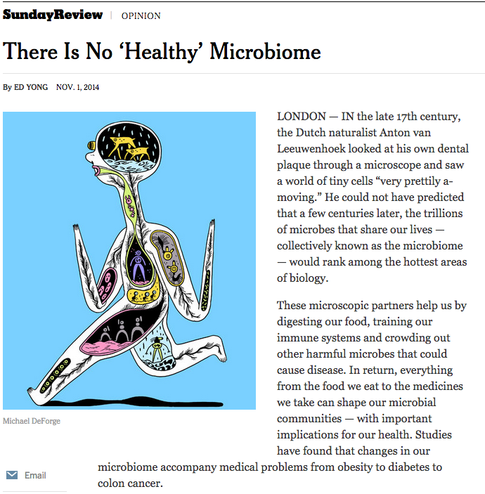

Slide 10
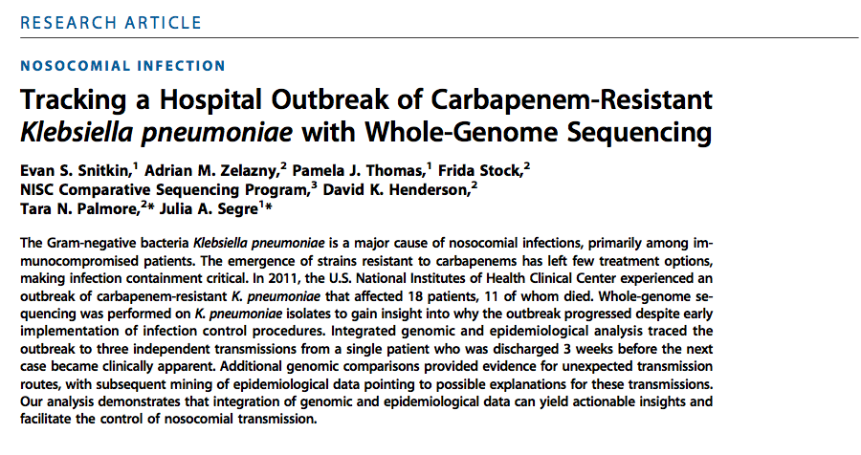

Slide 11
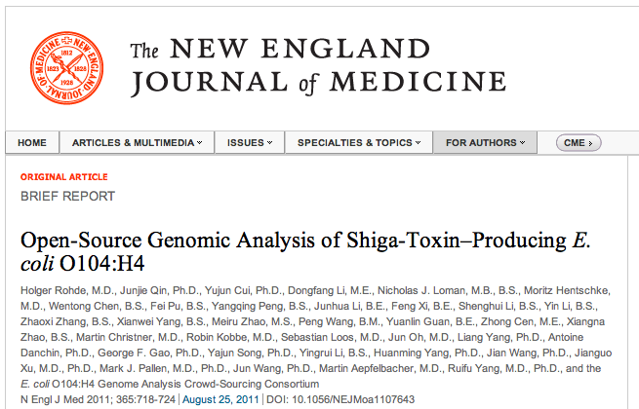

Slide 12
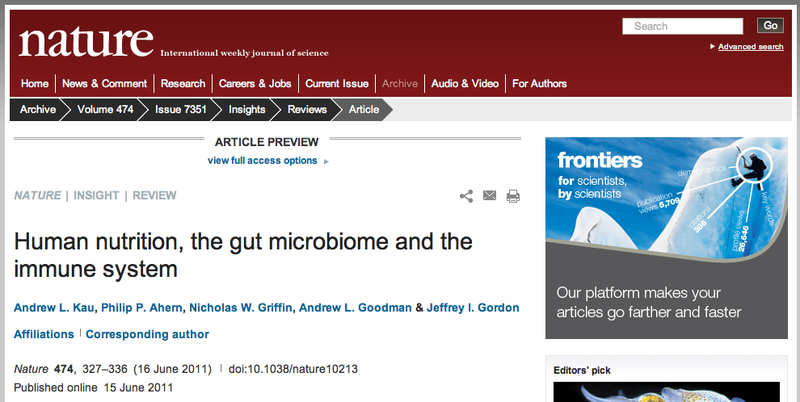

Slide 13
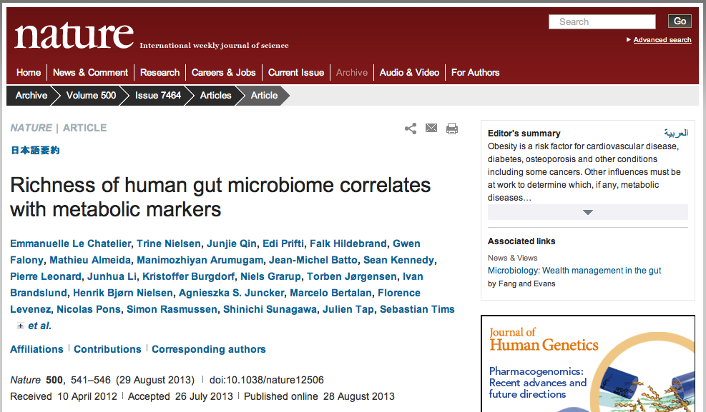

Slide 14
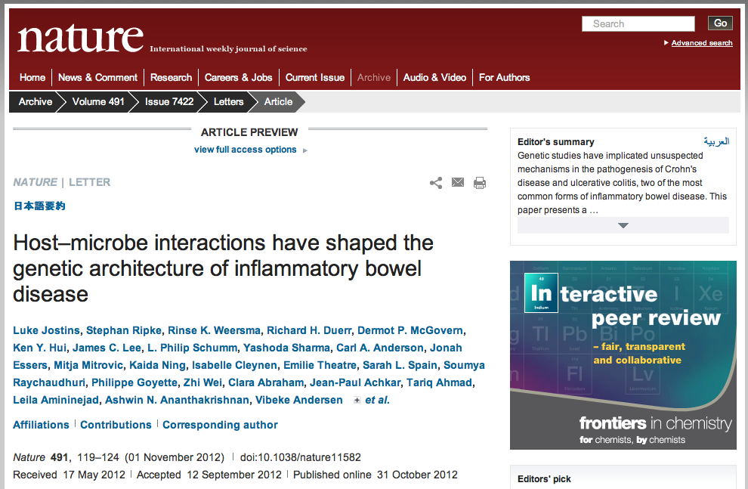

Slide 15
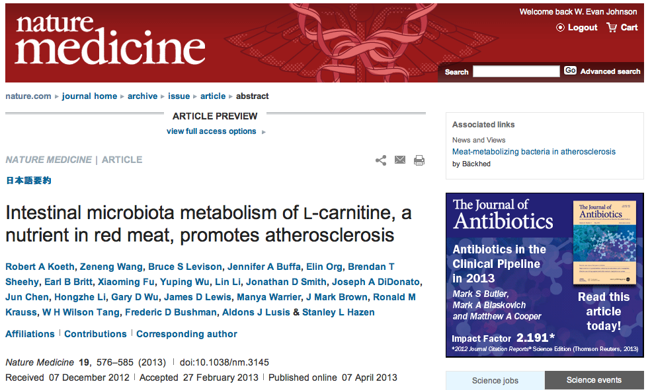

Slide 16
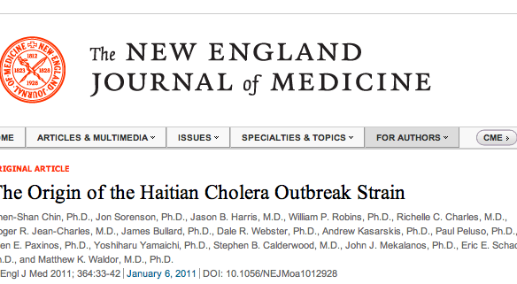

Slide 17
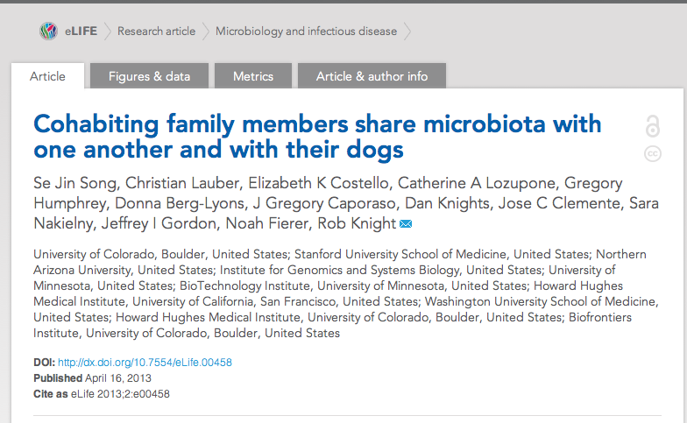

Slide 18
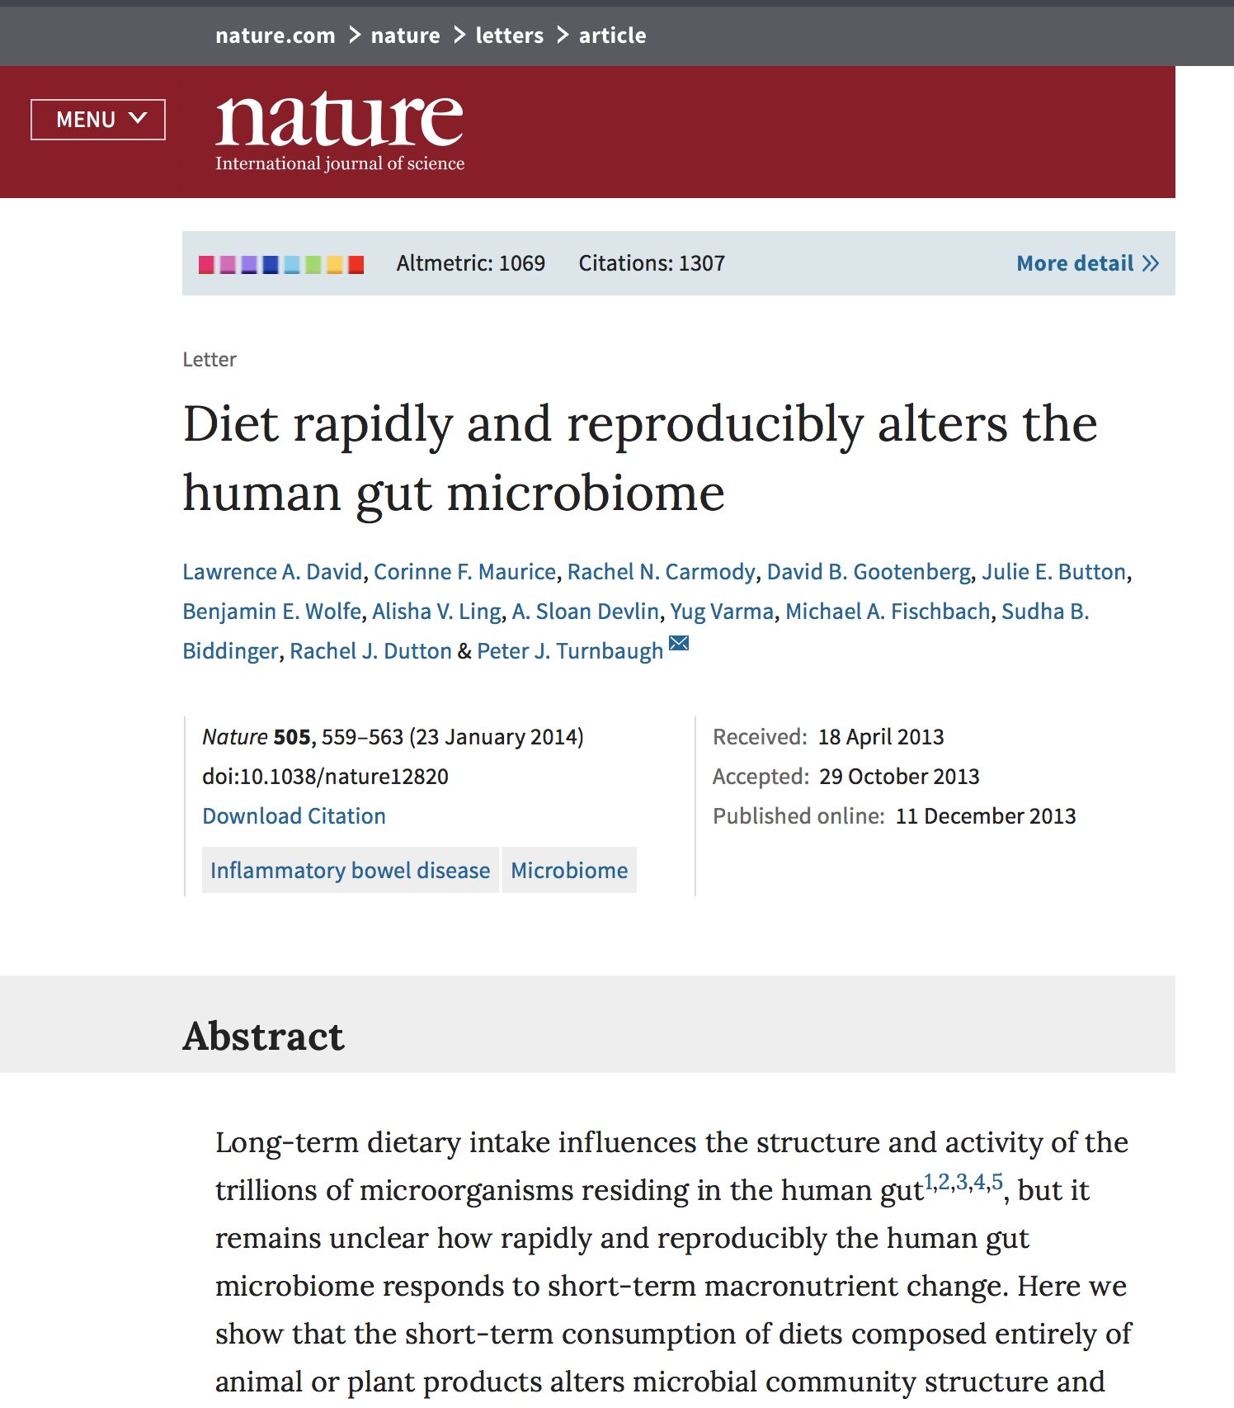
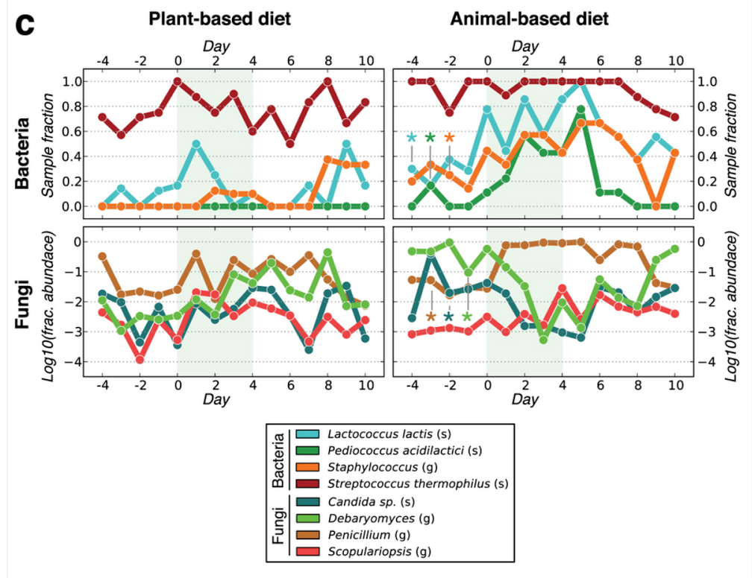

Slide 19
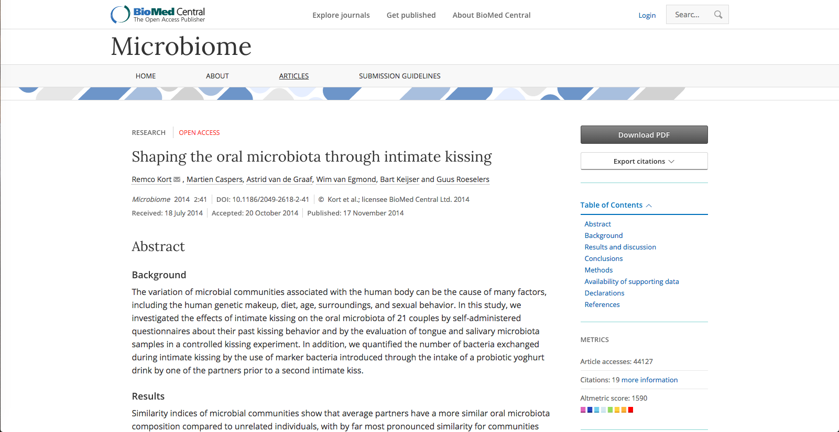

Slide 20
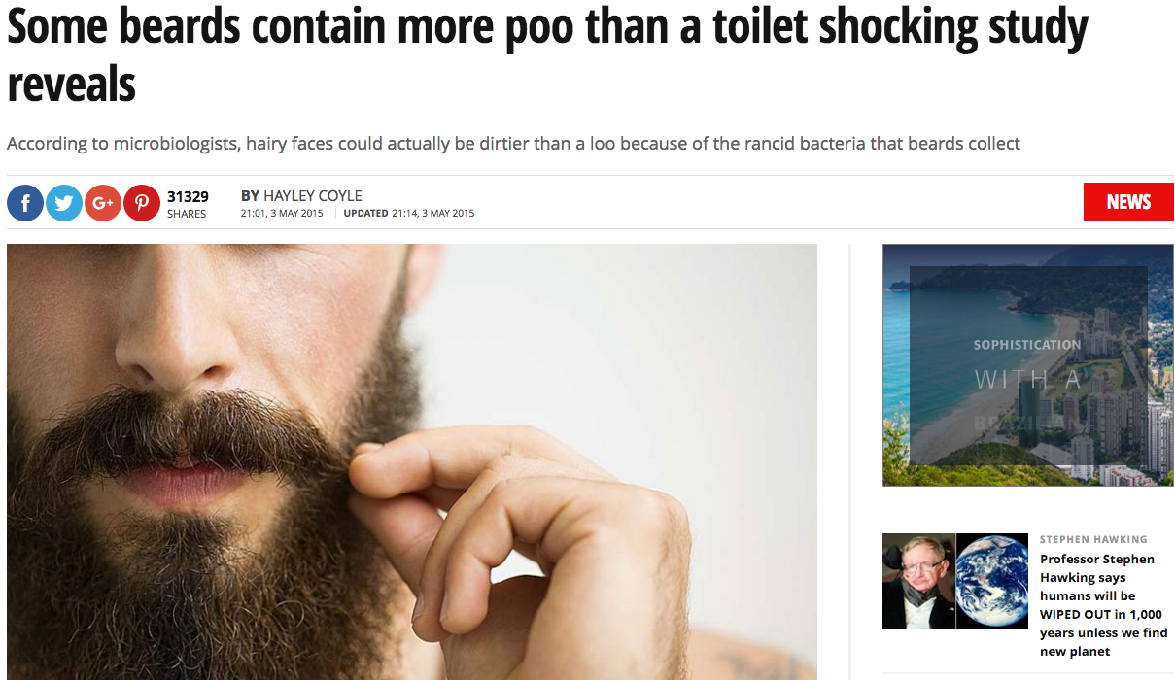

Slide 21
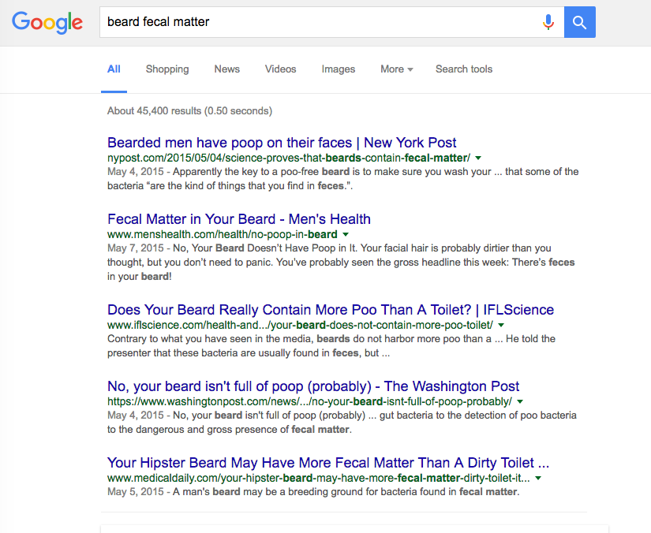

Slide 22
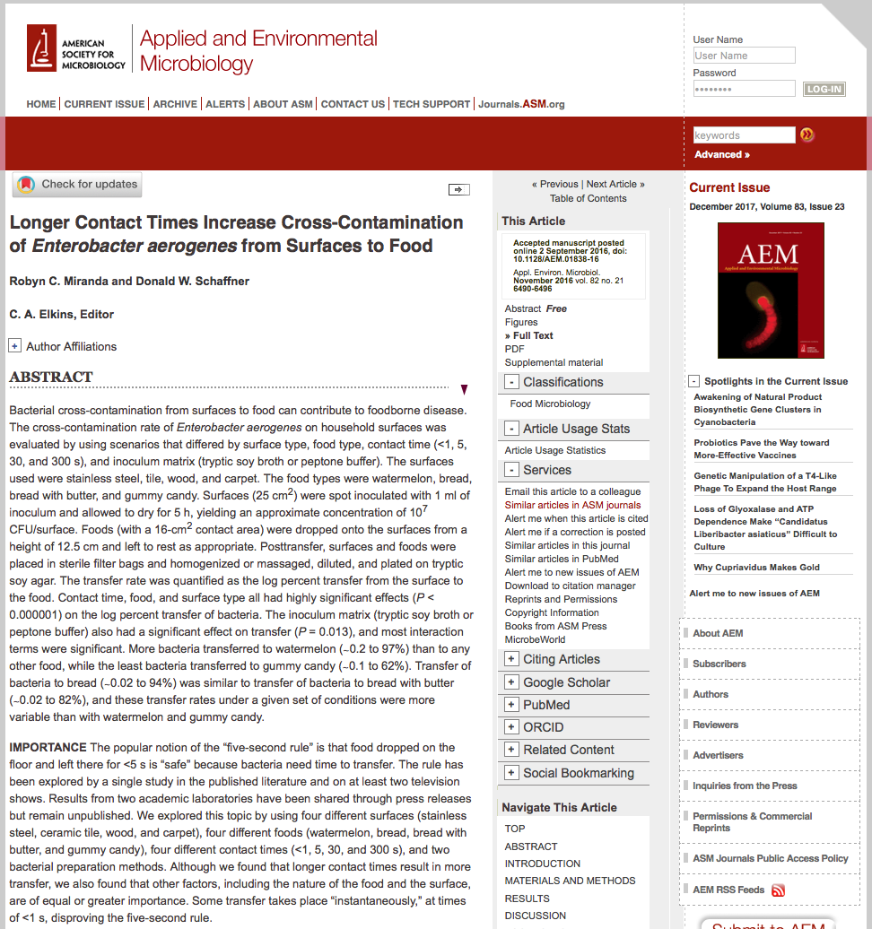

Slide 23
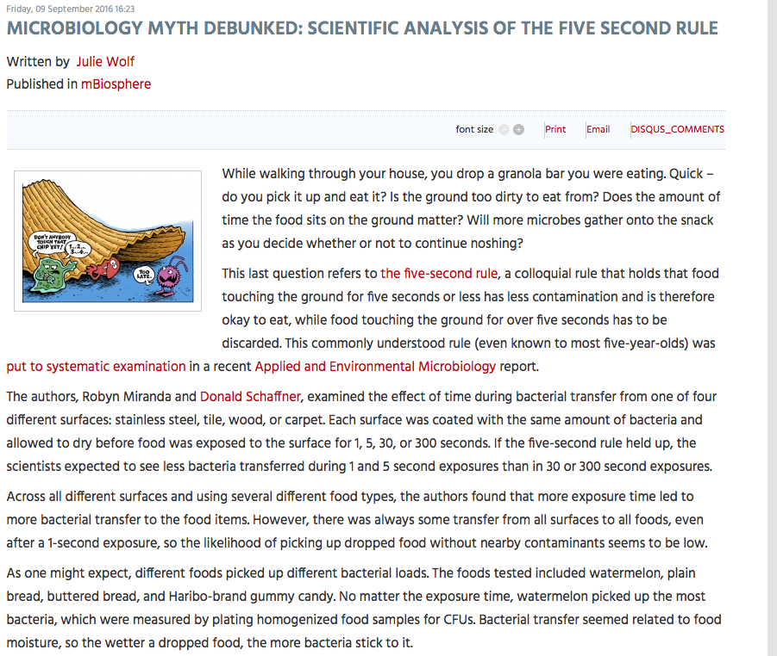

Slide 24
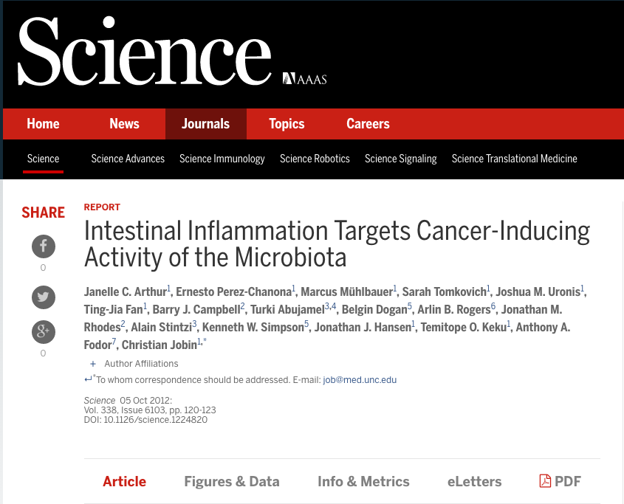

Slide 25
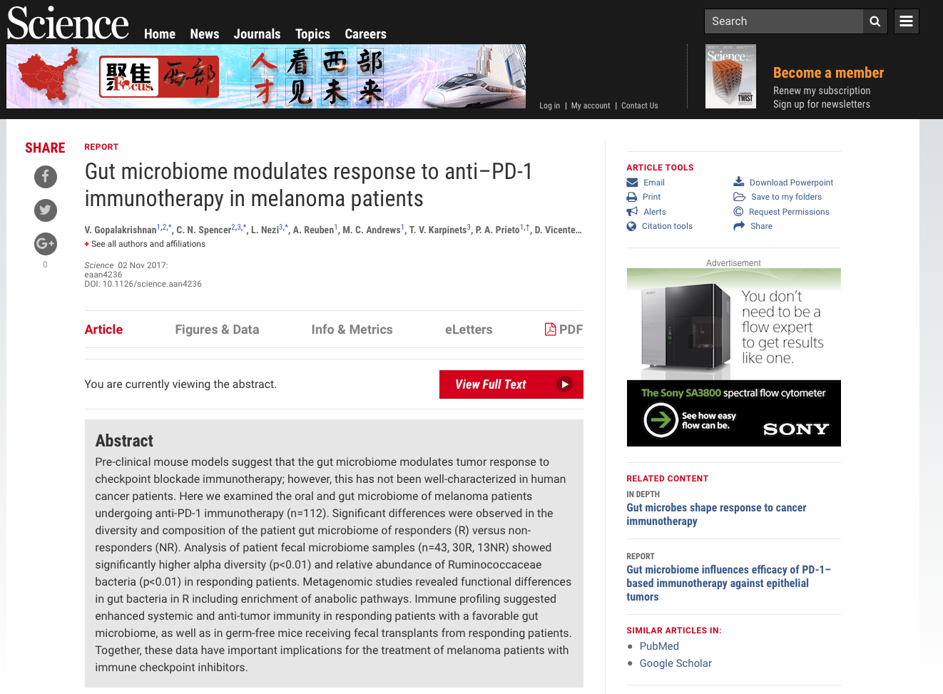

Slide 26
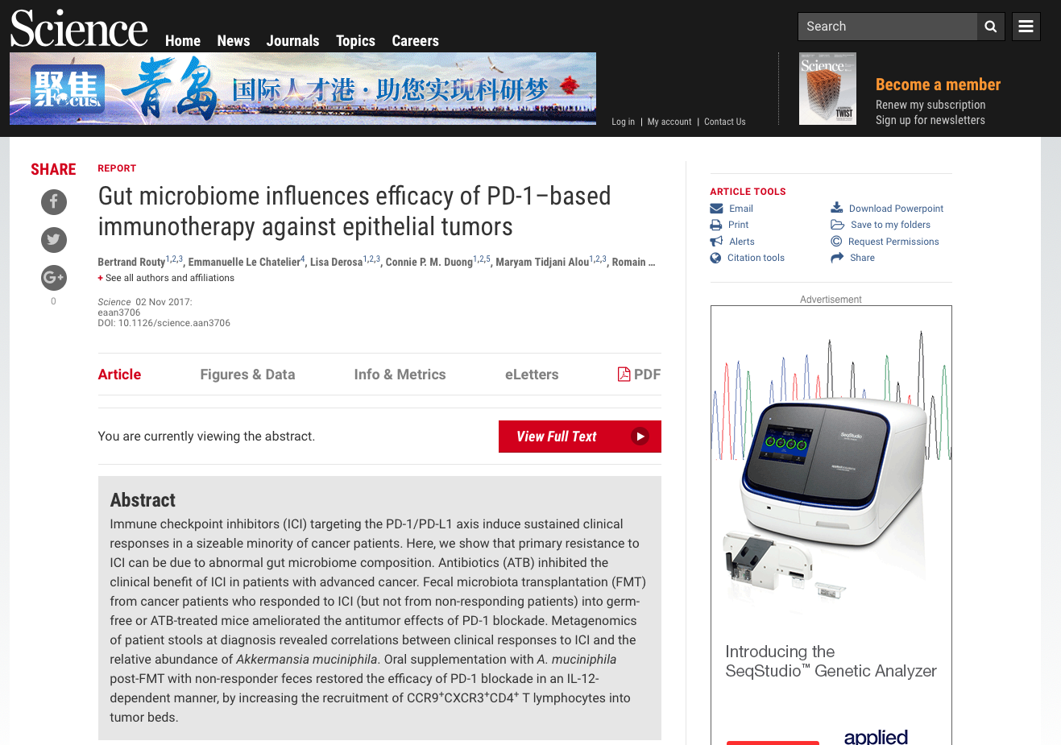

Slide 27
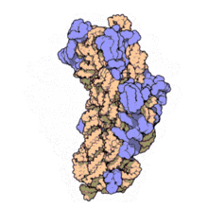
16S Ribosomal Sequencing
PCR amplify and sequence ~1.5kbp
Advantages
Conserved in bacteria (all have one)
Highly variable regions: identify taxonomy and phylogeny
Established and affordable
Disadvantages
Neglects viruses, fungi, parasites, etc
No strains or sometimes species identification
PCR bias?
The 16S subunit

Slide 28
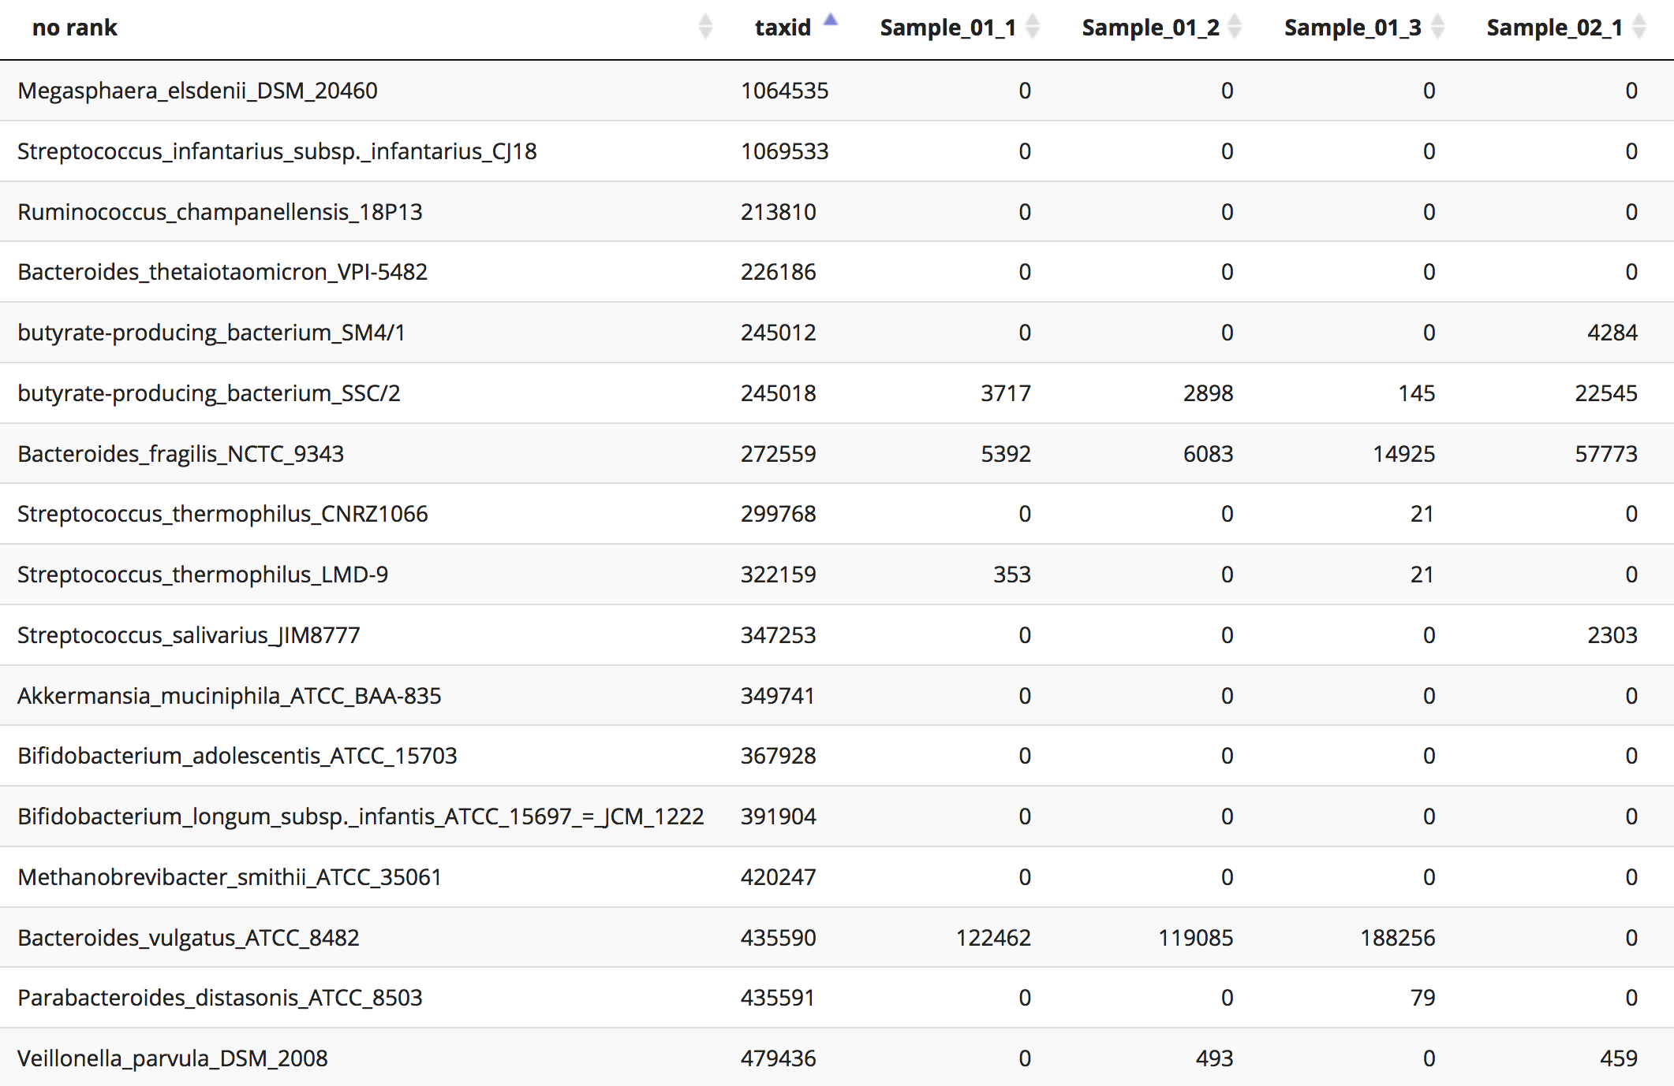
OTU Tables
Organization Taxonomic Units (OTUs)
Rows are microbes; columns are samples

Slide 29

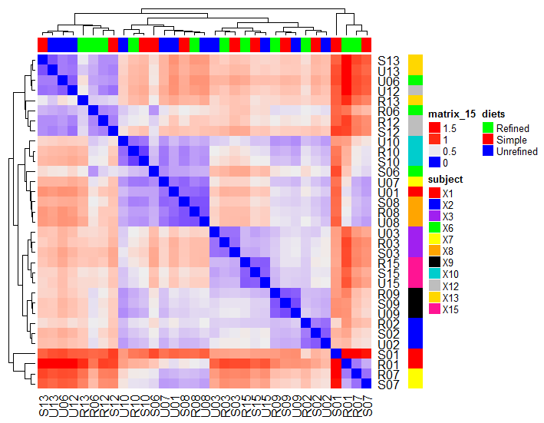
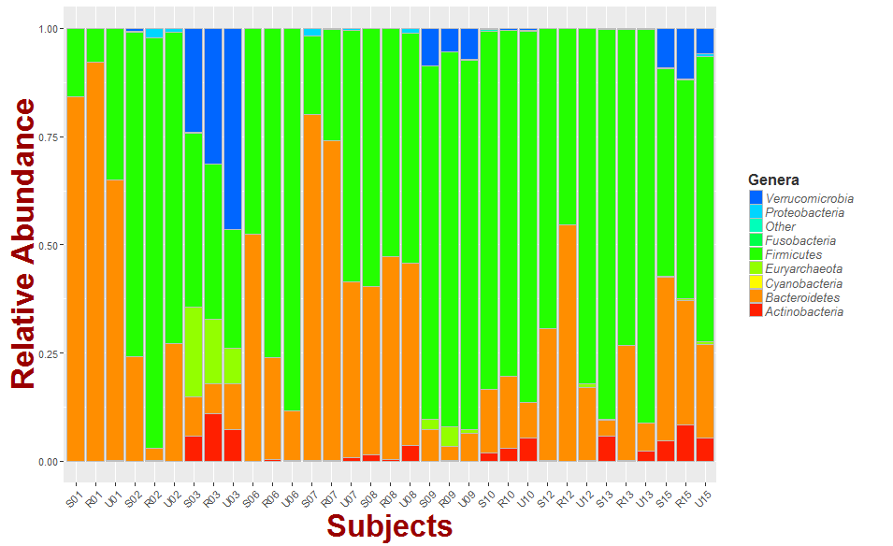
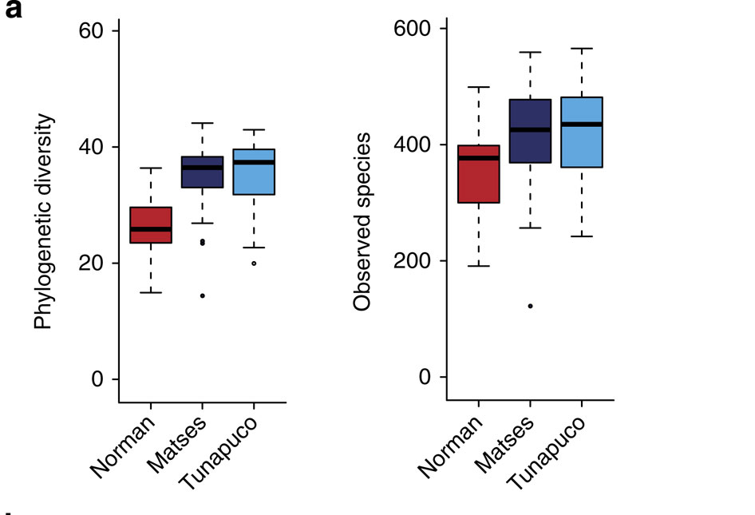
16S rDNA analysis
Qiime is a standard 16S analysis toolkit. It used PyNAST to align reads to your reference (probably greengenes), and can automatically spit out summary metrics and plots.
Alpha diversity
OTUs observed
Beta diversity
Taxa abundance

Slide 30
PathoScope: `Plug and Play' Metagenomic Framework
PathoScope Core Modules:
PathoLib: Automatic genome library extraction and optimization
PathoMap: Align reads and filter reads from host, etc.
PathoID: Reassign ambiguous reads, identify strains present, and estimate proportions of RNA/DNA
PathoReport: Summary reports, XML report, contigs, annotations etc
PathoScope Optional Modules:
PathoQC: Parallel quality control wrapper for multiple QC programs.
PathoDB: Extract annotation from NCBI (name, genes, products,lineage, etc)
Hong et al., Microbiome, 2015

Slide 31

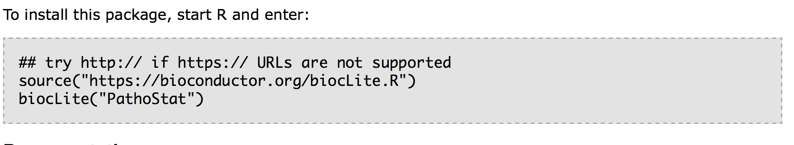
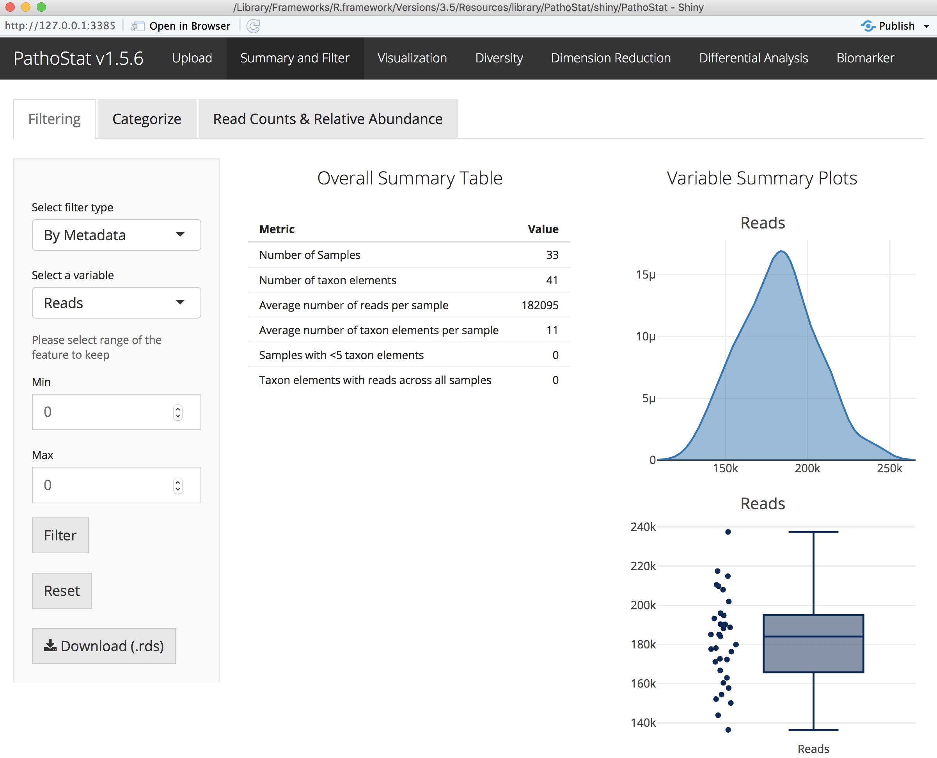
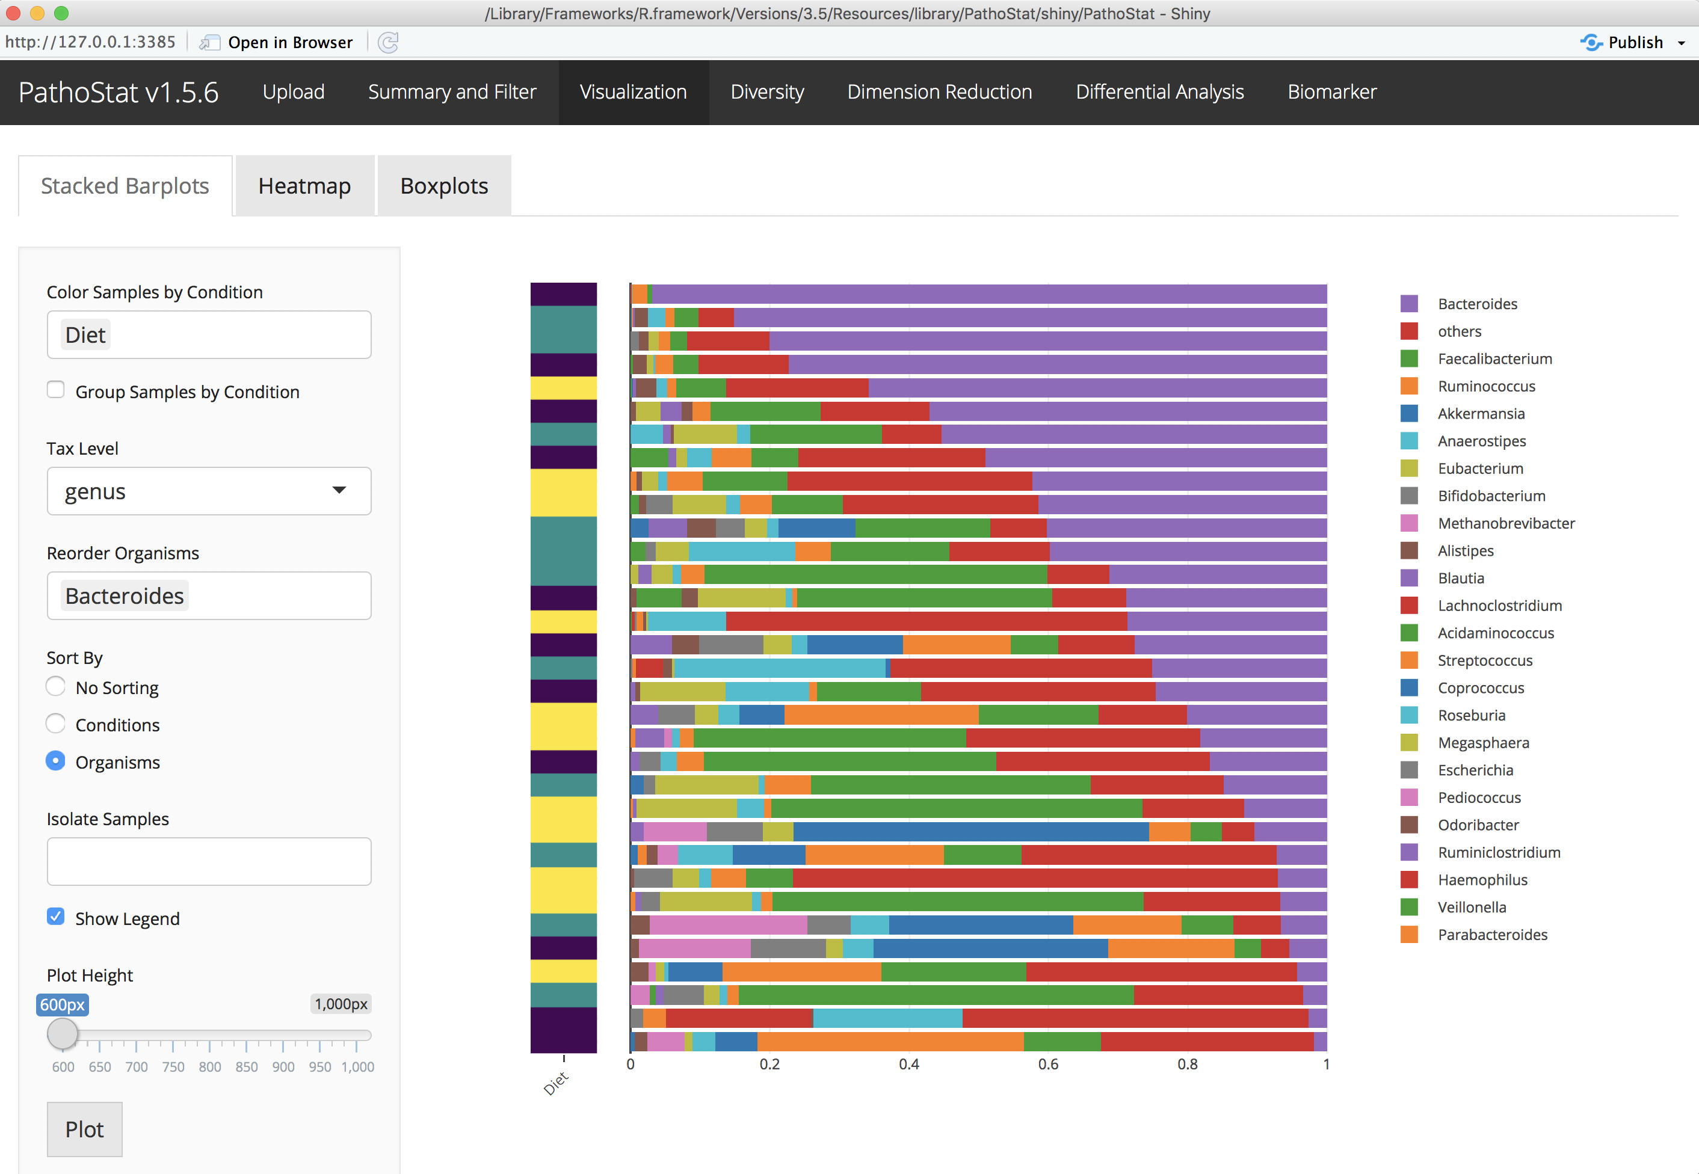
PathoStat (Bioconductor)
Planning to retire PathoStat, replace it with a full analysis pipeline “Animalcules”

Slide 32
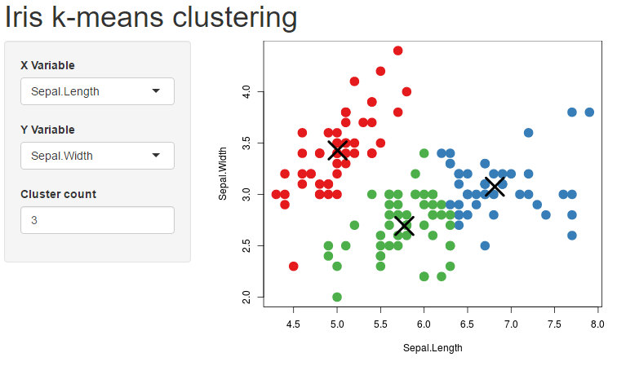
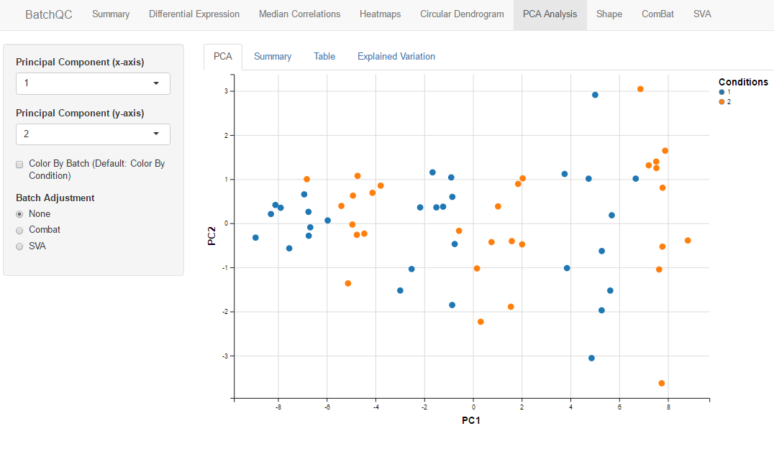
Shiny
Simple Web Apps Written in R
Interactive and Reactive
Customizable, Modular

Slide 33
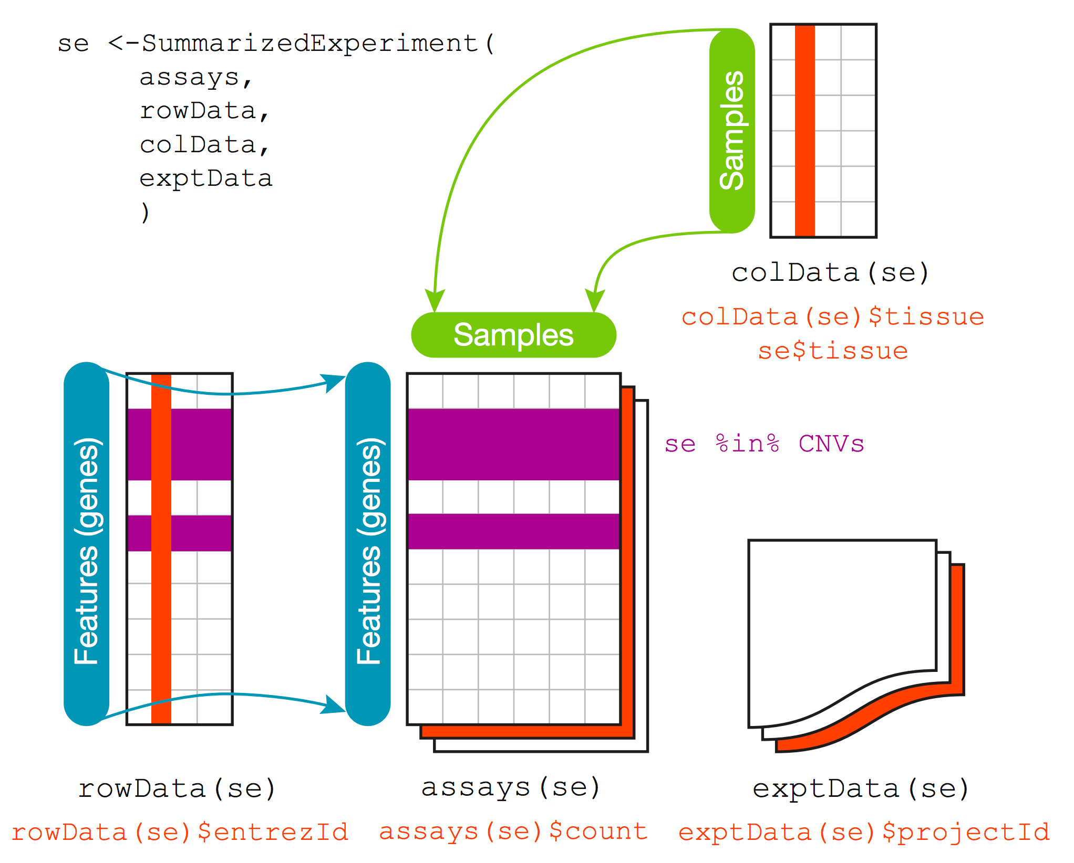
SummarizedExperiment
Notes:
Similar to ExpressionSet
More modern, not specifically made for microarray data, just general matrix data with row and column annotations
Can easily extend, MAST extends this object

Slide 34
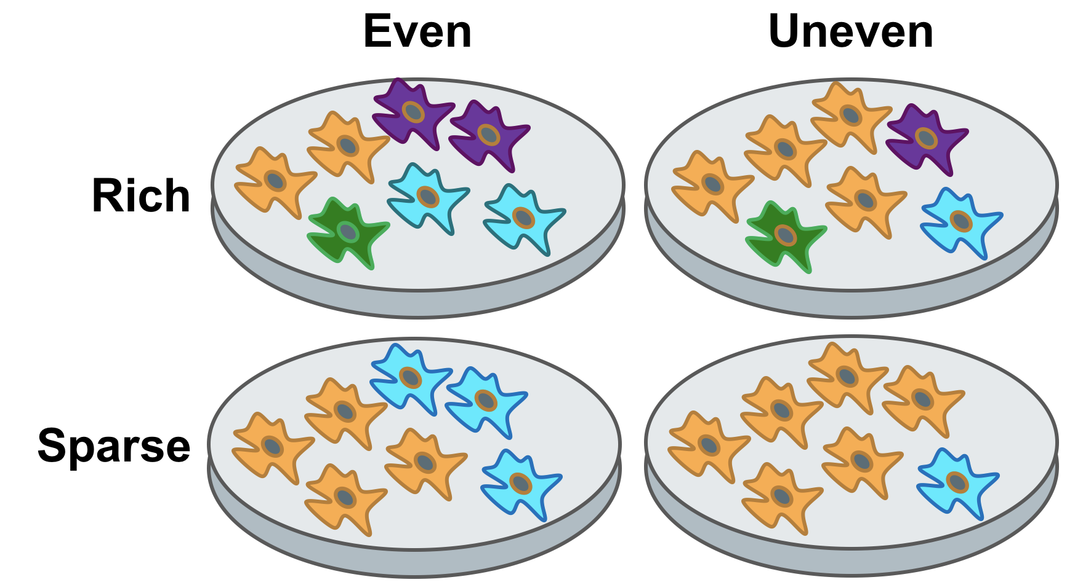
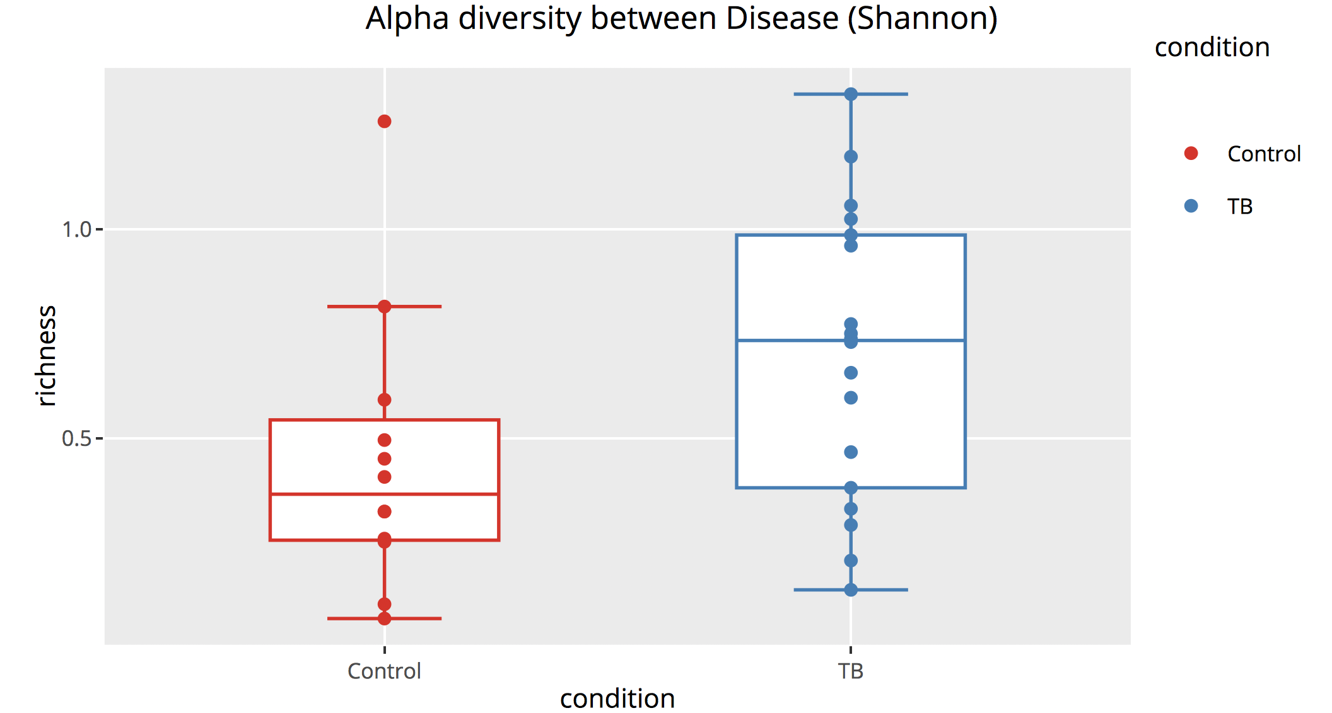
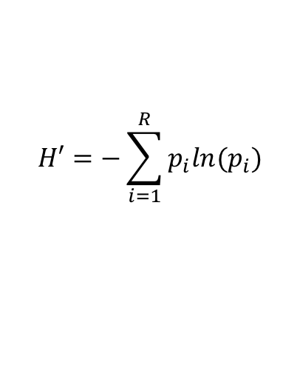
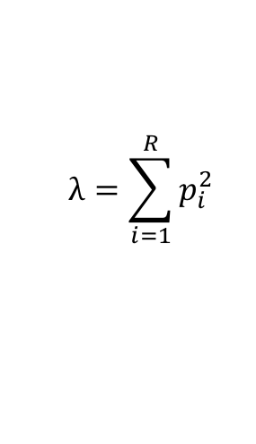
Alpha Diversity
Measures ‘richness’ of the microbiome
Number of species relative proportions
Simpson Index:
$$λ=\sum_{i=1}^{R}{p_{i}^{2}}$$
Shannon Index:
$$H′=−\sum_{i=1}^{R}{p_{i}ln{(p}_{i})}$$

Slide 35
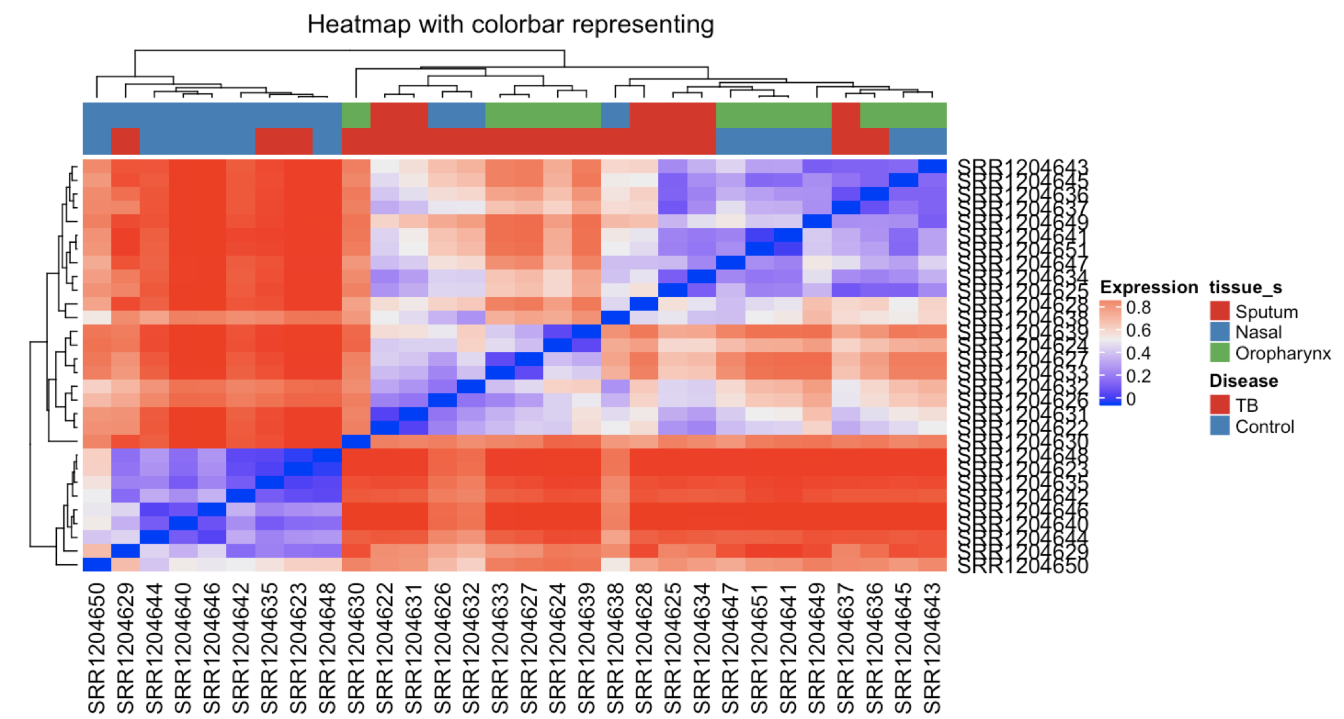
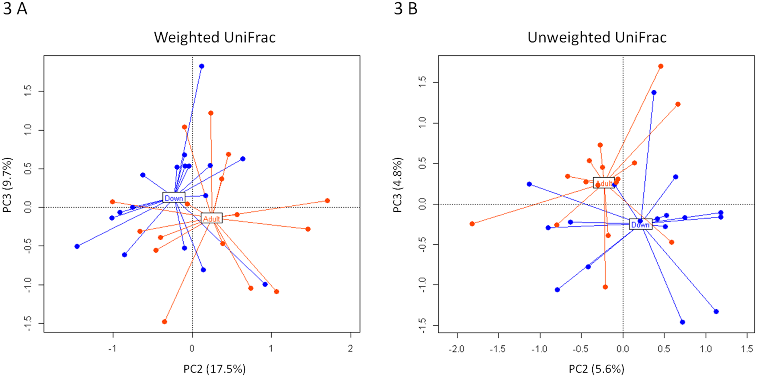
Beta Diversity
Measures similarity between two samples
Microbiome equivalent for ‘correlation’
Weighted Unifrac:
Biagi, et al., PLOS One 2014

Slide 36
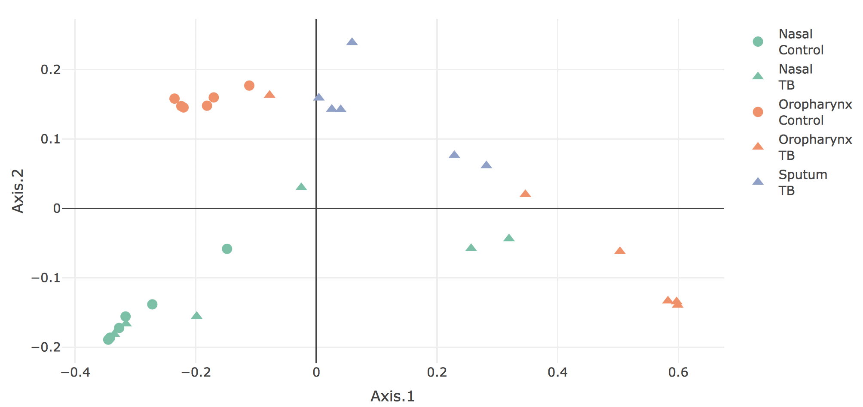
Principal Coordinate Analysis
Dimension reduction for metagenomic data
Example TB microbiome in multiple tissues:

Slide 37
Whole Metagenome Sequencing
Sequence whole (fragmented) DNA
Advantages:
Not limited to bacteria (viruses, fungi, parasites)
No PCR amplification bias
Disadvantages:
Host contamination in reads
Analysis:
Align to whole genome library
Need to filter host reads

Slide 38
Xenosurveillance
NGS analysis of bloodfed An. Gambiae from Liberia
Mosquito midgut (e.g. Acinetobacter, Pantoea)
Human skin microbes (e.g. S. epidermidis, P. acnes)
P. falciparum, Epstein-Barr (EBV), canine distemper virus (CDV)
Hepatitis C?? HIV?
Importance of high-
quality data analysis
Grubaugh et al. Xenosurveillance: a novel mosquito-based approach for examining the human-pathogen landscape. PLoS Negl Trop Dis. 2015

Slide 39
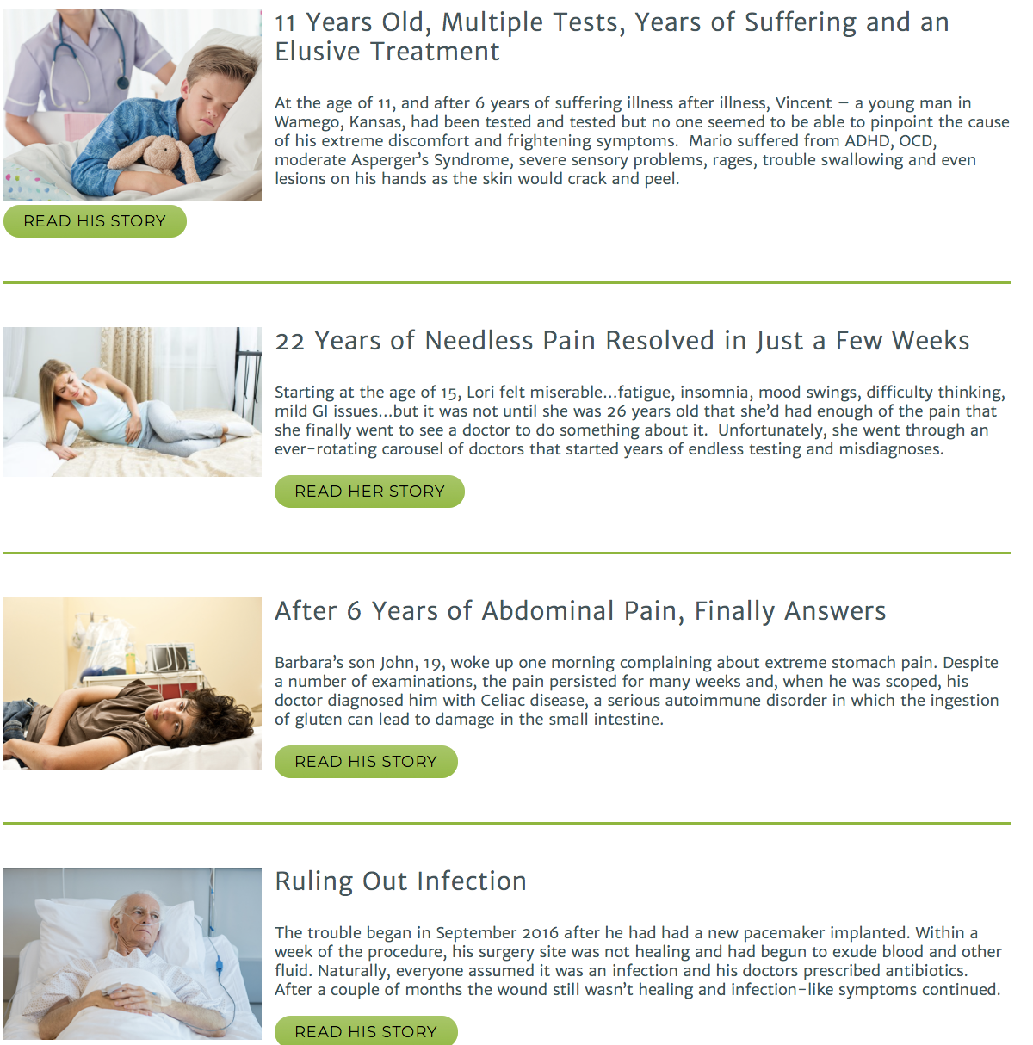

Aperiomics
Metagenome sequencing to solve hard-to-diagnose infections
Pleural Effusion:
F. nucleatum

Slide 40
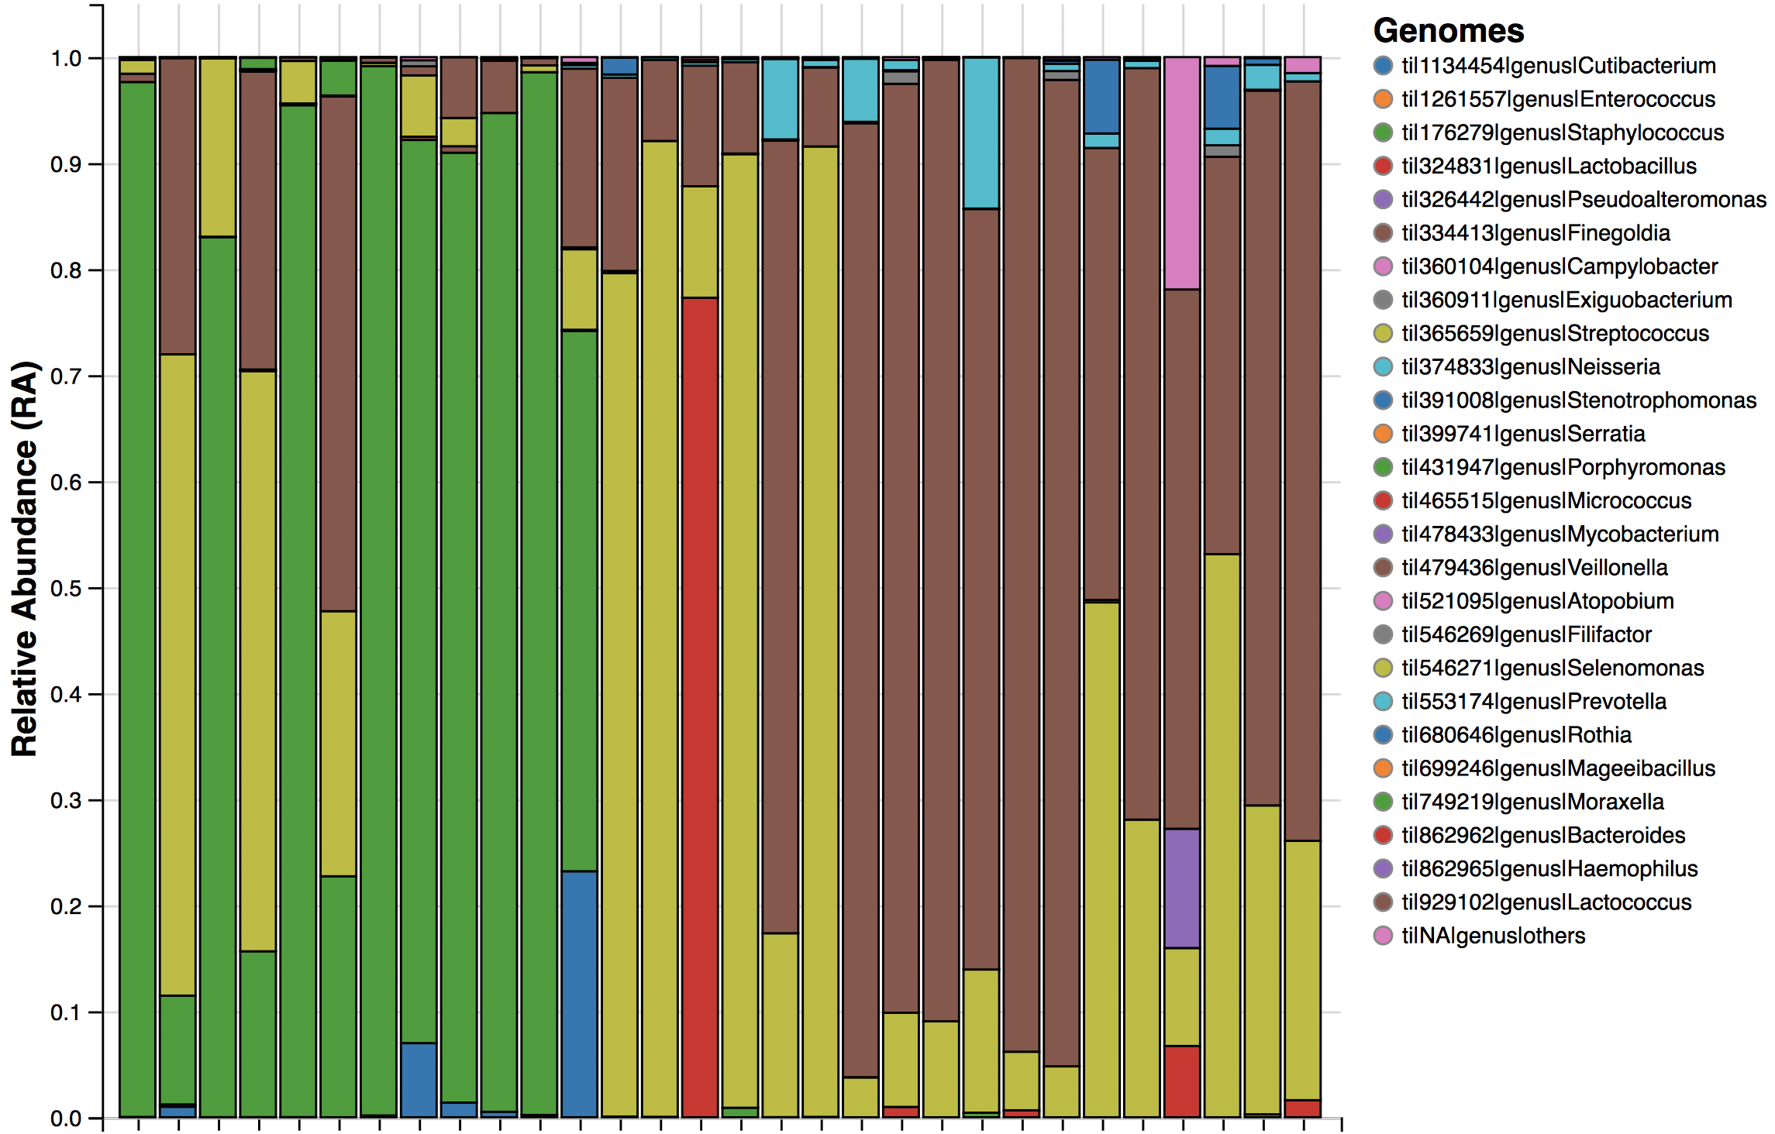
Airway Microbiome of TB
Nasal
Oral
Sputum
TB
Control
TB
Control
TB

Slide 41
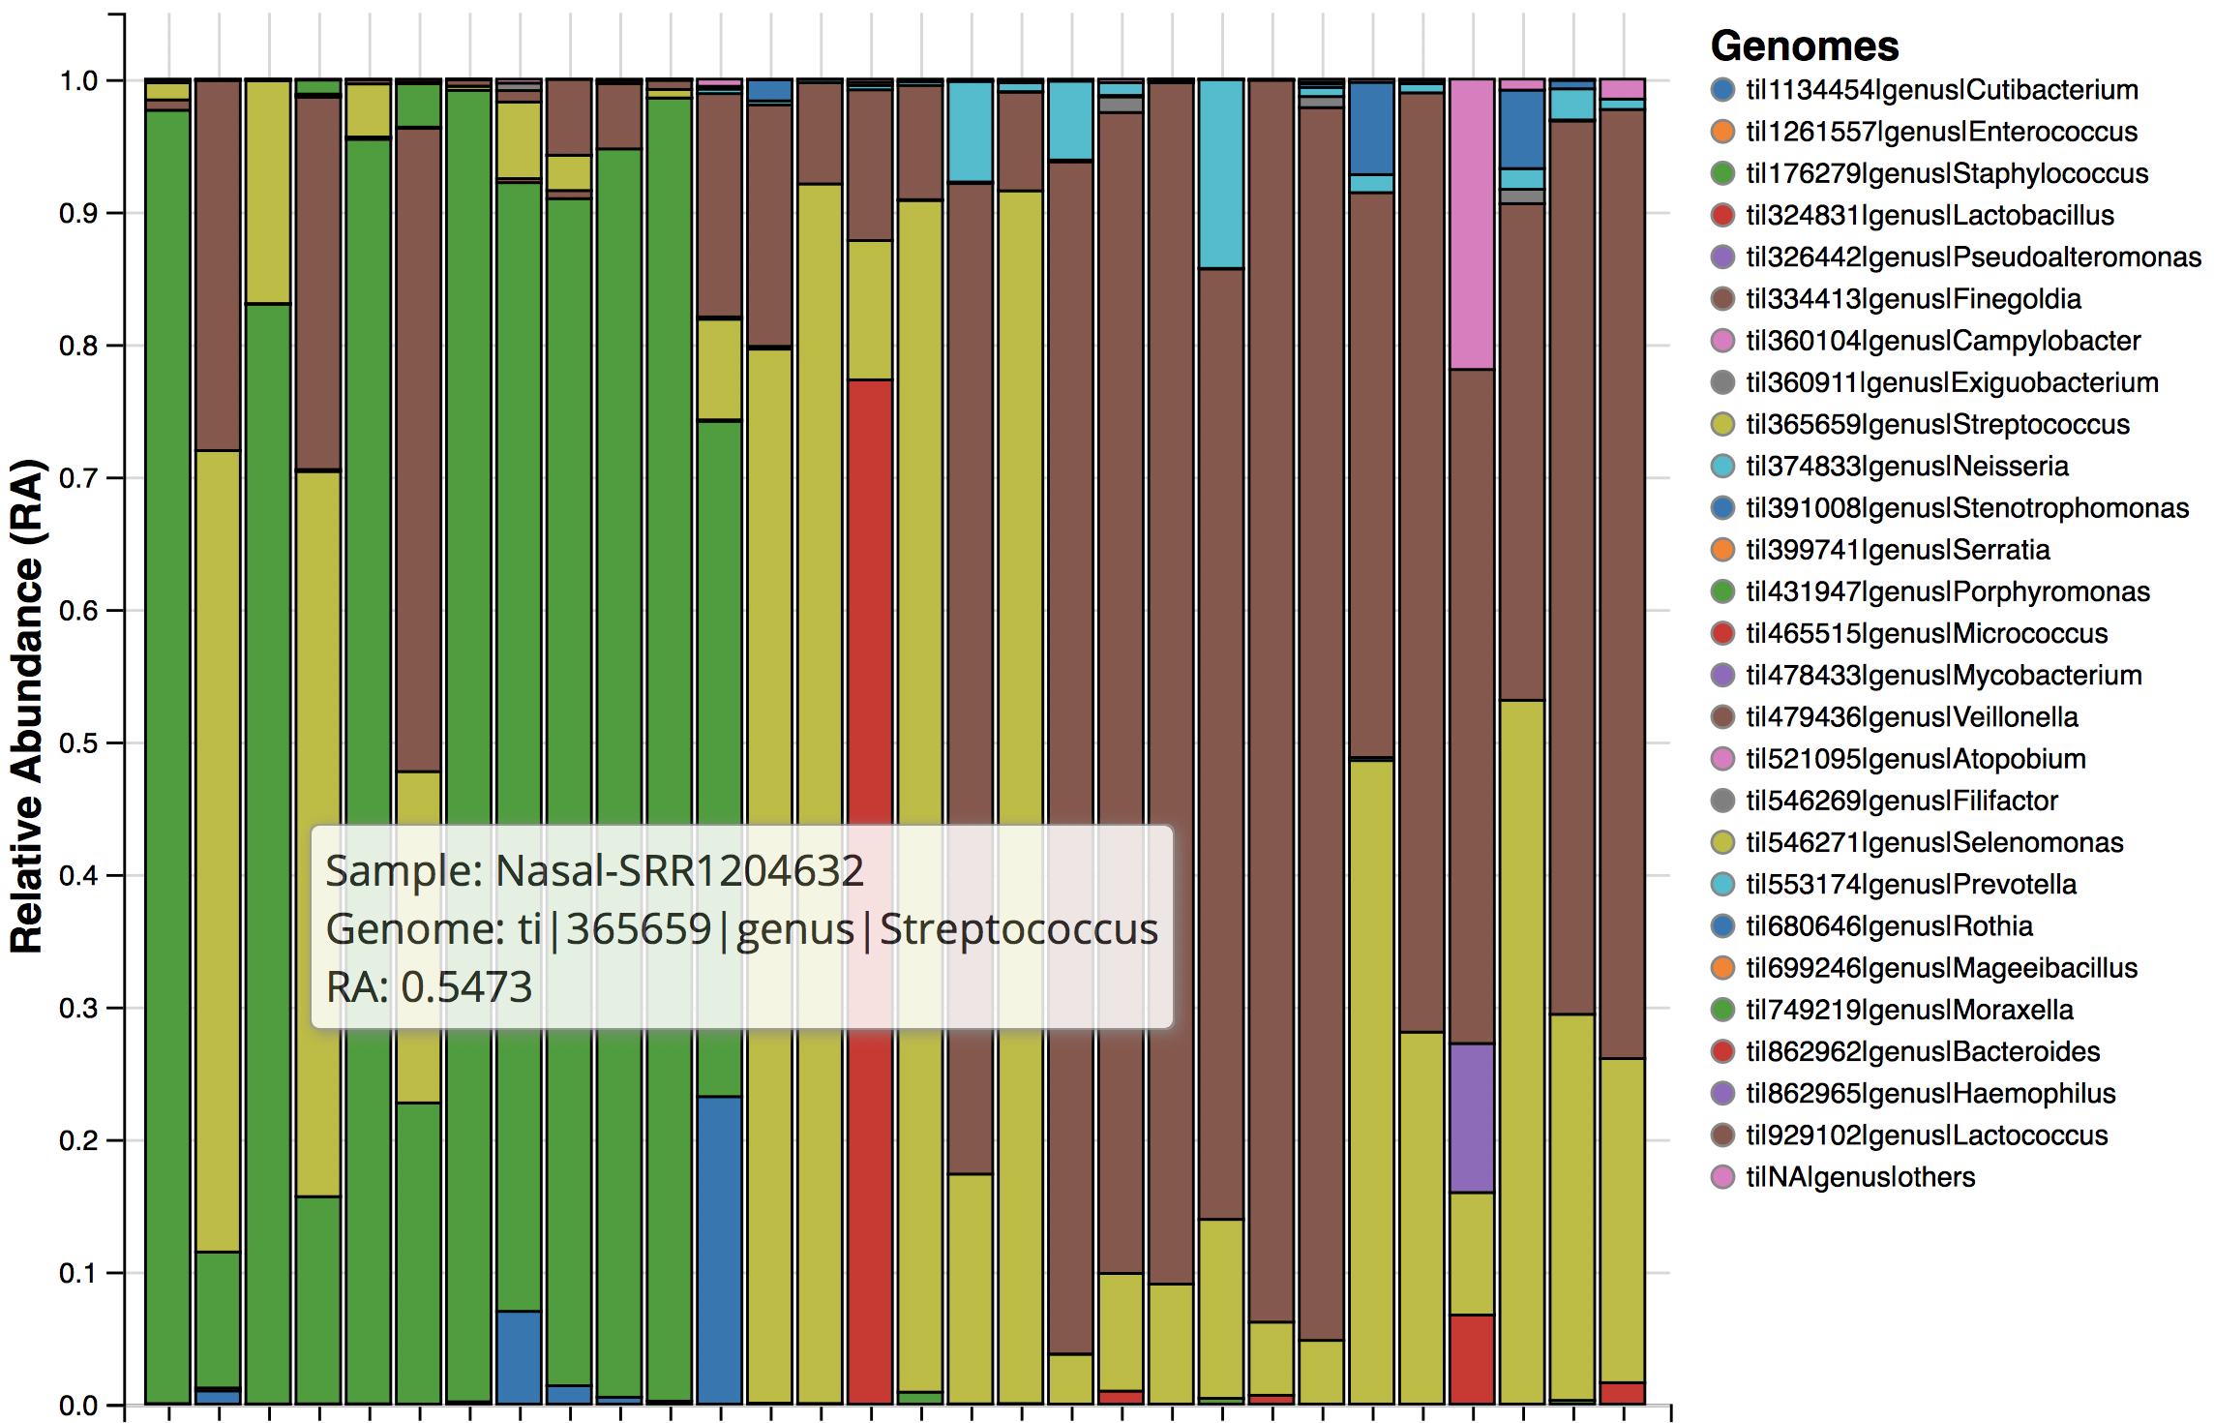
Airway Microbiome of TB
Nasal
Oral
Sputum
TB
Control
TB
Control
TB

Slide 42
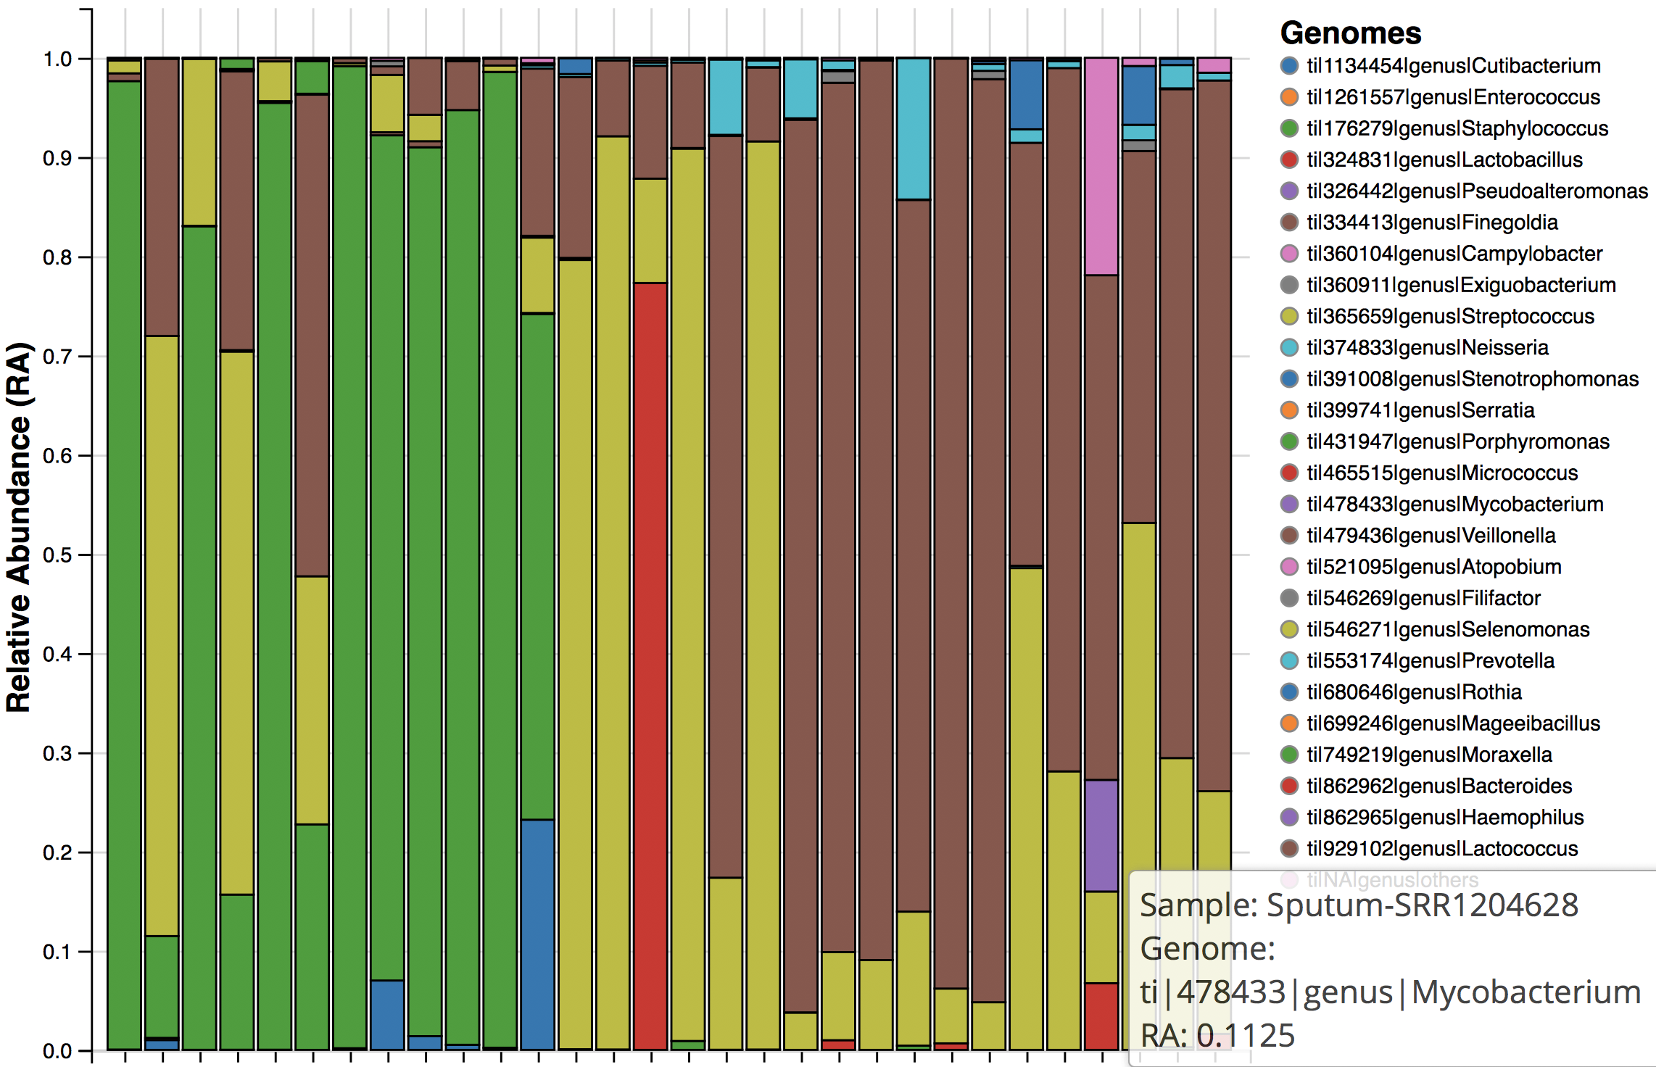
Airway Microbiome of TB
Nasal
Oral
Sputum
TB
Control
TB
Control
TB

Slide 43
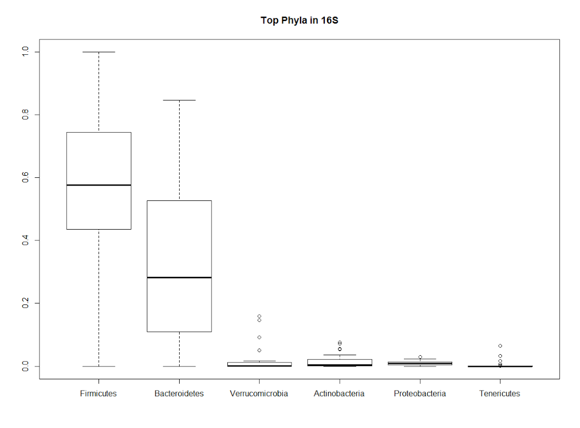

Metatranscriptome Sequencing
Sequence total RNA (deplete ribosomal RNA)
Get host transcription AND microbiome profile
Measures activity NOT abundance
Top Phyla in 16S rDNA-seq
Top Phyla in whole RNA-seq
Fermicutes Verrucomicrobia Proteobacteria
Bacteroidetes Actinobacteria Tenericutes
Fermicutes Euryarchaeota Proteobacteria
Bacteroidetes Actinobacteria Verrucomicrobia

Slide 44










Collect specimen
RNA Sequencing
Host Response Pathways
Pneumonia
Influenza
Genome Library
PathoScope Analysis
(Genome Research, 2013)
Influenza
E. coli
ASSIGN Profiling
(Bioinformatics, 2015)
RSV
Pneumonia
Plague
Anthrax
Human
HIV
Align to Human Genome
Align to Microbial Genomes
Influenza
Pneumonia
RSV
Pathway Activation
Human
Bayesian Mixture Modeling
Sparse Baysian Factor Analysis
Pathogen Abundance
Microbial Abundance
Immune Pathway Activity
Control Asthma
Microbiome and Host
Response in Asthma
(BMC Med Genomics, 2015)

Slide 45

Asthma Nasal Metatranscriptomics
‘Healthy’ asthmatic (n=8) and control children (n=6)
Nasal brushings, Total RNA-seq
Castro-Nallar et al., BMC Medical Genomics, 2015

Slide 46

Asthma Nasal Metatranscriptomics
Microbime Profiling
Castro-Nallar et al., BMC Medical Genomics, 2015

Slide 47

Nasal Lung Cancer Biomarkers

Slide 48
Nasal Lung Cancer Biomarkers
Host gene expression in nasal epithelium is similar to bronchial epithelium
Nasal epithelial gene expression predicts cancer (AUC= 0.81; CI= 0.74 to 0.89)

Slide 49

Lung Cancer Metatranscriptomics
Former and current smokers; lung nodule (CT scan)
Nasal brushings; Total RNA-seq

Slide 50

Lung Cancer Metatranscriptomics
Lung microbiome in cancer is less diverse:

Slide 51

Lung Cancer Metatranscriptomics
Genera Present in Lung cancer and controls:
Actinomyces:
Cause Actinomycosis, which can masquerade as lung caner
Actinomycosis sometimes co-exists with lung cancer
Dolosigranulum:
Dolosigranulum pigrum can cause infections in the upper respiratory tract and nosocomial pneumonia and septicemia
Saccharomyces
A genus of fungi that includes many species of yeasts.
Used as vaccine against cancer: Ardiani et al., FEMS Yeast Research 2019

Slide 52

Lung Cancer Metatranscriptomics
Preliminary microbiome biomarker: AUC=0.802
Combination biomarker: host+microbiome?

Slide 53
Our Future Efforts
Further Software and Tool Development:
R toolkit and visualization
Longitudinal analysis
Airway metatranscriptomics for TB/HIV:
Microbiome, TB, and co-morbities:
HIV/TB co-infection
Malnutrition
Smoking
Host + microbial biomarkers for TB and HIV
Paucibacillary TB, extrapulmonary TB, Pediatric TB

Slide 54
Acknowledgements
Pathoscope + Asthma
Changjin Hong
Mani Solaiappan
Yue (Jason) Zhao
Ying Shen
Keith Crandall (GWU)
Eduardo Castro-Nallar (GWU)
Robert Freishtat (CN)
Aperiomics
Keith Crandall (GWU)
Crystal Icenhour (CEO)
Yuan (Alvin) Chen (CSO)
Xenosurveillance
Supriya Sharma
Doug E. Brackney (CT-DES)
Lung Cancer
Yue (Jason) Zhao
Jiarui Zhang
Avi Spira
Marc Lenburg
Single Cell RNA-seq
Josh Campbell
BU Single Cell Core

